Slide 1
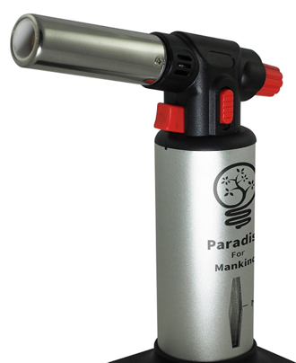
Our Values
Parts
Respect for Others
Please pack away each kit by the end of class with all the parts in them.
Respect for Robots
Don’t let the robots drive off the tables. Don’t let the robots get stepped on. Keep them in a corral if you have one.
Safety
Please don’t do dangerous things with our robots. We strongly suggest doing the flamethrower labs outdoors.
Bot MBox Inventory:
Robot
2.4 G Dongle
IR Remote
USB Cable
Manual
Figure 8 floor map
Bluetooth Daughter Board (not for large classrooms)
4 AA extra batteries

Slide 2
Circuits
Motor Direction
An electric circuit is a path in which electrons from a voltage or current source flow.
Our job is to make robot move by making current move through motor circuits.
An motor circuit is a circuit that tells the motor how fast to turn and in what direction it turns. By changing the polarity on a motor you can change its direction it turns.
Forward Spin
switch
battery
+
Direct current
motor
-
Reverse Spin
GND

Slide 3

H-Bridge Circuit
Motor Speed
A H-Bridge circuit is a circuit that allows the direction of a motor to be reversed by closing different switches
We can change the speed that a motor spins by changing the voltage applied to the motor. The higher the voltage the faster the motor spins.
Our motors will use a voltage from 2 to 6 volts.
2 volts - slow
Forward
Reverse
6 volts - fast

Slide 4
Driving Forward
Driving Backward
To drive forward, both wheels need to be turning forward at the same time. To drive in a straight line both motors need to be going at the same speed.
To drive backwards, both wheels need to be turning backwards.
Mbot Robot

Slide 5
Turning
Driving in a square

